Slide 1
ABOUT THIS TEMPLATE
This PPT template can be used internally and externally. It is meant to ensure brand alignment across all ESI divisions and support units.
TIPS
Questions?
Aim for consistency between slides (e.g., alignment, sizing of text and images, etc.).
If copying content into the template from another PPT, right click and select the option “Use Destination Formatting.”
  This will prevent the old formatting styles from being copied into the new PPT.
Example quotes, icons, and stats have been included on the last slide.
If you have any questions on how to use the template or need additional assistance, please contact Marketing.
email MarketingTeam@esiconstruction.com

Slide 3
PRESENTER NAME | TITLE
STRENGTH | STRENGTH | STRENGTH | STRENGTH | STRENGTH

Slide 4
AGENDA

Slide 5
Notes:
Second agenda option

Slide 7
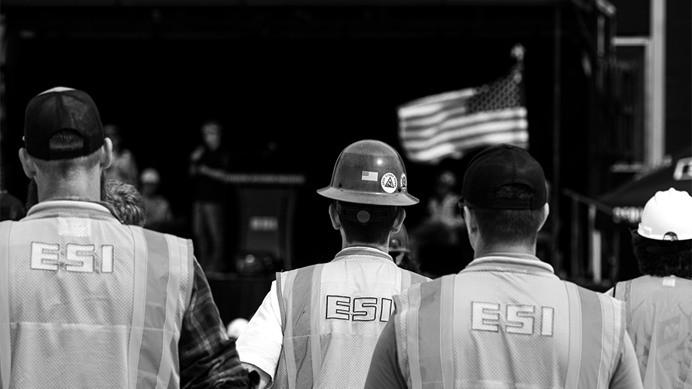
If you want to replace slide image:
-Picture Format>Change Picture
-Set picture transparency at 75%
(Black & White images preferred)
EXAMPLE
DIVIDER
TITLE

Slide 11

ACTIVE LISTENING SKILL
Active Listening requires you to listen attentively, understand what others are saying, respond and reflect on what’s being said, and retain the information.
Active listening exercise
Most people do not listen with the intent to understand; they listen with the intent to reply.
Ask a clarifying question, stay curious
“Interesting, say more about that…”
“Can you give me an example?”
“Could you tell me a bit more about that?”
“What I’m hearing is…”
- STEPHEN R. COVEY

Slide 14


EXAMPLES – ICONS, QUOTES, AND STATS
CONTENT
85
Proposal Requests
19
Drone Shoots
39
Progress Shoots
XX
XX
Proposal Requests
Proposal Requests
5
Corporate Emails
15
Videos
24
Finished Shoots
Most people do not listen with the intent to understand; they listen with the intent to reply.
XX
XX
Proposal Requests
Proposal Requests
ASSETS
XX
XX
100
Video Clips
1k+
Images
219
Headshots
Proposal Requests
Proposal Requests
- STEPHEN R. COVEY

